Slide 1
Stray Animals Tracking Mobile App
CMSE 201 GROUP 12

Slide 2


PROJECT PLAN
Aim of the project
Functional requirements
Non-functional requirements
User interface

Slide 3
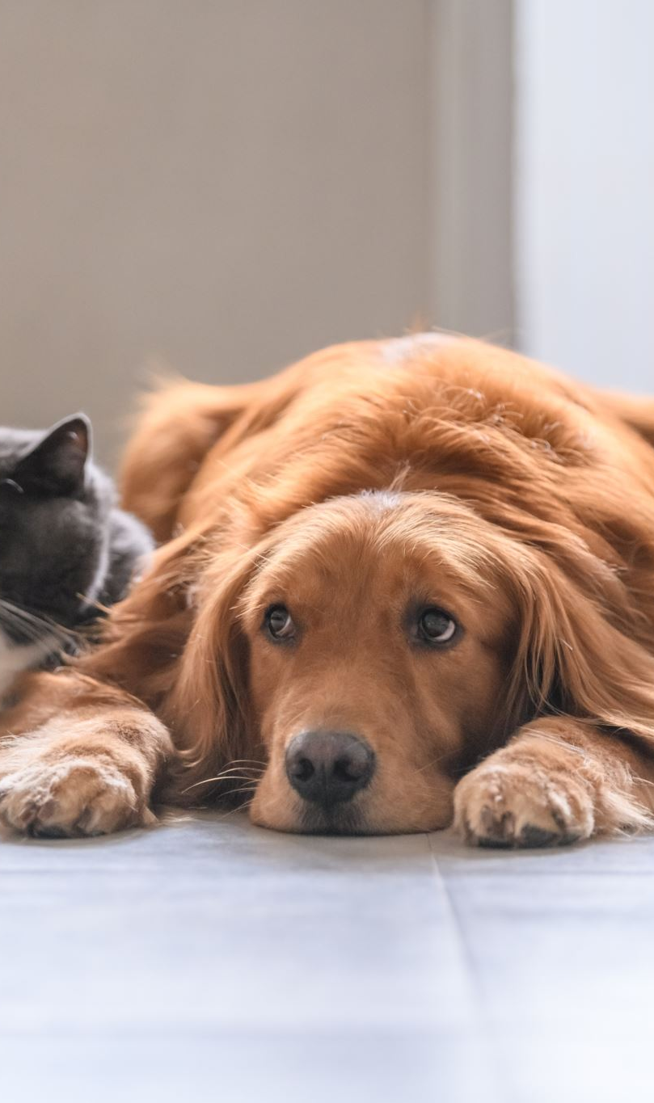
Aim of the project
The goal of this project is to develop a mobile/web application to provide foster care/sponsorship for stray animals (dogs and cats). The software will link stray animals to appropriate authorities and organizations. In other words, the purpose of this project is to help stray animals that do not have a home or owner.

Slide 4
Functional requirements
Create account
Login/logout
Edit profile
Delete account
Choosing pet for adoption
See the pets live location
Add/delete a pet for adoption
Login and logout as a volunteer
Volunteers can view adopters information and history

Slide 5
Non-functional requirements
The response time of the system should be fast
The log in information should be verified within five seconds
Loading time for the user should take less than two seconds
The system must not have so many errors
Logging out should take no more than 3 seconds
The system should be able to do numerous tasks at the same time
A heavy workload should not be a problem for the system
When dealing with data the system should be accurate

Slide 6
Non-functional requirement safety and security requirements
Data security: users’ data must kept secure, and precaution must be taken to prevent malevolent intruders from accessing it.
Update and maintenance: the system must be updated and maintained on a regular basis. This reduces security weaknesses.
Dos protection: the application servers must be protected from Dos assaults. the application may become inoperable in the case of such an assault.
To avoid data loss due to the system failure, all system data must be baked up every 24 hours and the backup copies kept in a safe location in the database
Access to the various subsystem must be safeguarded by a log in page and requires user information(Email and password)

Slide 7
Non-functional requirement safety and security requirements
Data security: users’ data must kept secure, and precaution must be taken to prevent malevolent intruders from accessing it.
Update and maintenance: the system must be updated and maintained on a regular basis. This reduces security weaknesses.
Dos protection: the application servers must be protected from Dos assaults. the application may become inoperable in the case of such an assault.
To avoid data loss due to the system failure, all system data must be baked up every 24 hours and the backup copies kept in a safe location in the database
Access to the various subsystem must be safeguarded by a log in page and requires user information(Email and password)

Slide 8

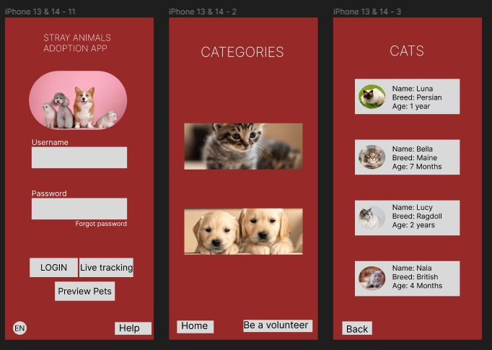
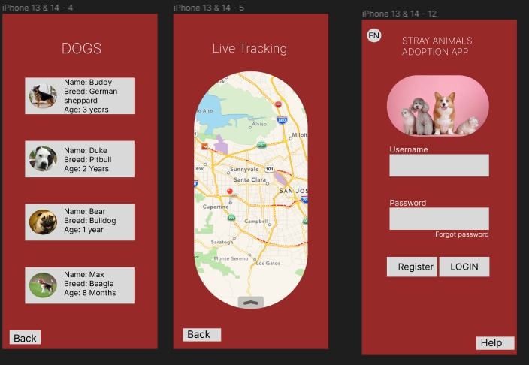


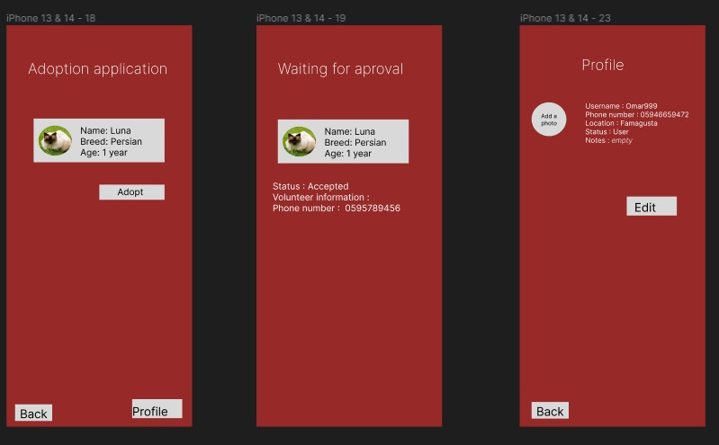

User Interface

Slide 9
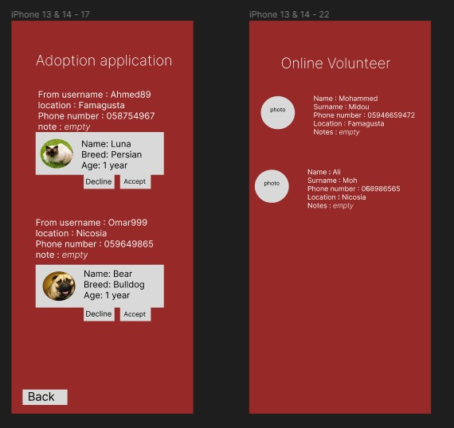
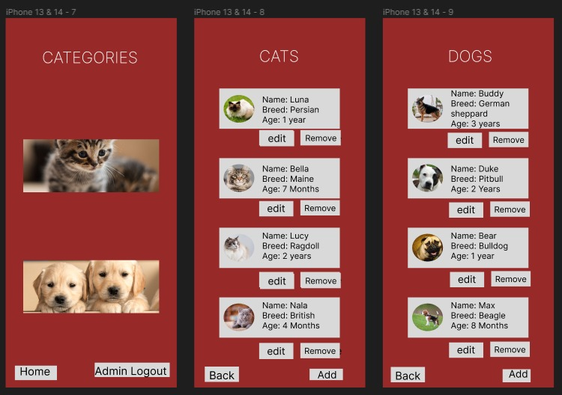
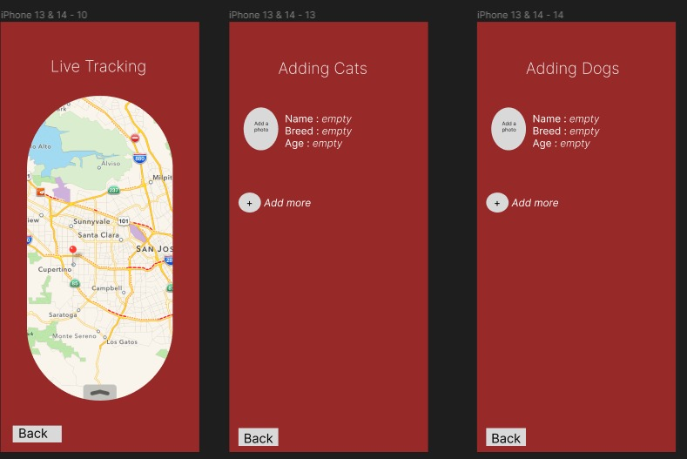
Admin interface

Slide 10
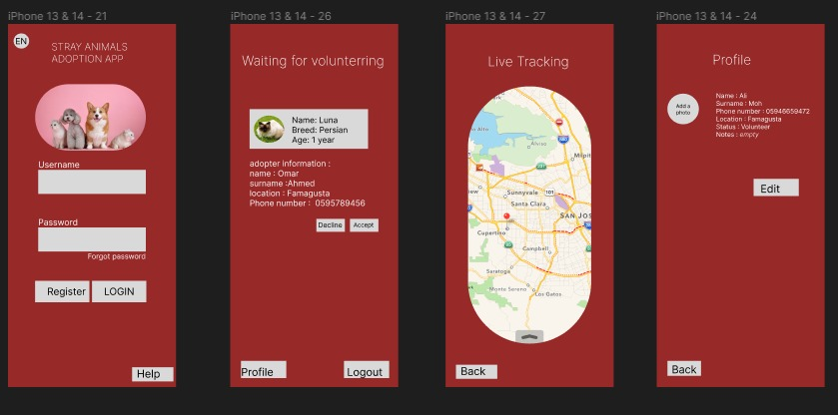
Volunteer interface

Slide 11

The end thank you for listening

